Slide 1

PlantBuddy
By: Team ʕ•ᴥ•ʔ g̡̡̧̞̥͖̣̫̔̓͑̂̑̂ͪ͋̐ͣ̀̚̚͘i̷̧͕̜͎̮̬̖̼̗̺̭͙̠̗̲͚̘̬̊ͥ̎͂̅̆ͩ̇̾̊̿ͤ̀͢ḋ̴̵̂̐ͮ͛̓͛͂ͪͪ͢҉̘̤̞̩̝̩͍̣̹͖̥̖̗̟͍̜͇͈g̡͐̊́ͭ̍̒̔̓͊͞҉̴̲̠̫̙͔̺̺̙̤͔ũ̸̸͉͔͈̘̬̭͐ͭ͆̑͌̅͆ͪ̂̇̌̓ͣ̃ͪ͊̕͜͜d̷͚̳̯̝͙̫̥̯͚͙ͪ̄̐ͤ͂͋ ̴̡̧̩͓̺̥͚̬̪̹̭̥̜̪͈̳̜͖̊̆̂ͨͦ͑ͨ̊̄̌̏̄ͭ͞

Slide 2
The Team
Andersen Chan
Roman Huts
Dean Wedgbury
Daniel Wang
Eugene Au Yeung
Dominik Loncar

Slide 3
Introduction
Arduino-based automatic plant maintenance system:
The Plant Buddy is a device that measures the moisture levels in the soil of a small indoor potted plant and releases a valve to water it based on the observed moisture level.
On top of this, the Plant Buddy system will also measure data such as data such as: temperature, moisture, and humidity over time.
The system will also be able to present the data back to the User, and make graphs to help visualize the data. These graphs will be available on a website that the user can log into.
Access the website for on the go control.
Notes:
Eugene

Slide 4
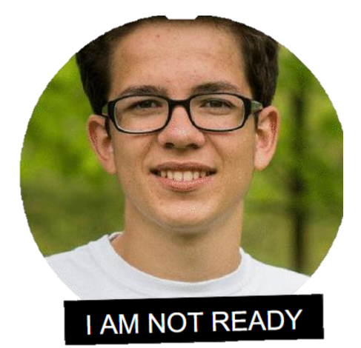
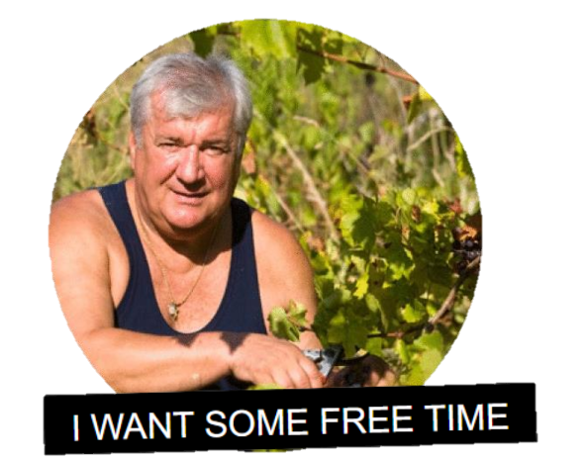
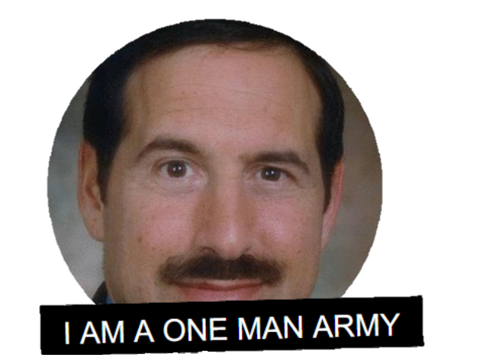
Personas
Racnol Kinimod (The Beginner)
Looking for a smart device at a college student allowance.
Device to allow them to slowly adapt to their new lifestyle and responsibilities.
Nahc Nesredna (The Competitive Hobbyist)
Needs an option to water plants on the go(travelling).
Little and minimal setup and interference on his part
Amed Ryli (The Researcher)
Needs a device that can substitute rudimentary tasks assigned to research students.
Device needs to be analyze and graph data.
Notes:
Wang

Slide 5

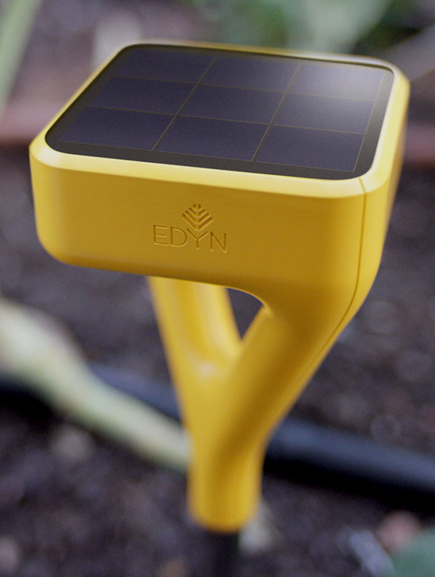
Competitors
Their product:
Automatically measures and waters outdoor gardens based on a database of over 5000 plants
Our advantage:
Our product can operate offline, we don’t have to be connected to the internet at all times
We will not sell your data to third party companies
Modularity - add functionality you need and deserve with our open source code and open design.
Notes:
Dom

Slide 6
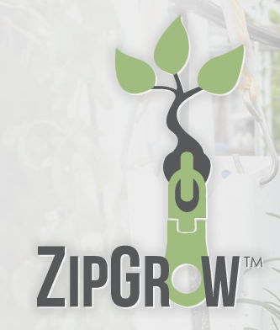
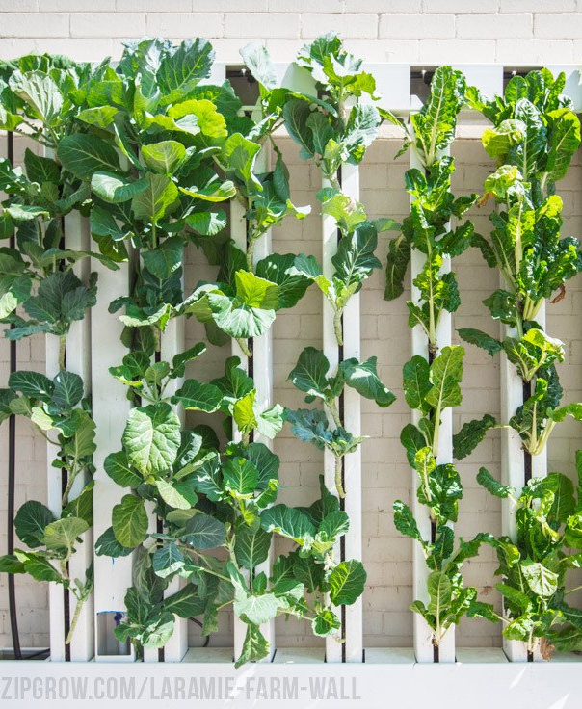
Competitors
Their product:
Tall vertical towers which automate watering and light source
Minimal interaction required once it's set up
Our advantage:
Our product can be monitored, tracked and interacted with online
Our product can be used on any plant, not a specific set of plants
Notes:
Dom

Slide 7
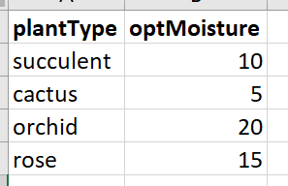
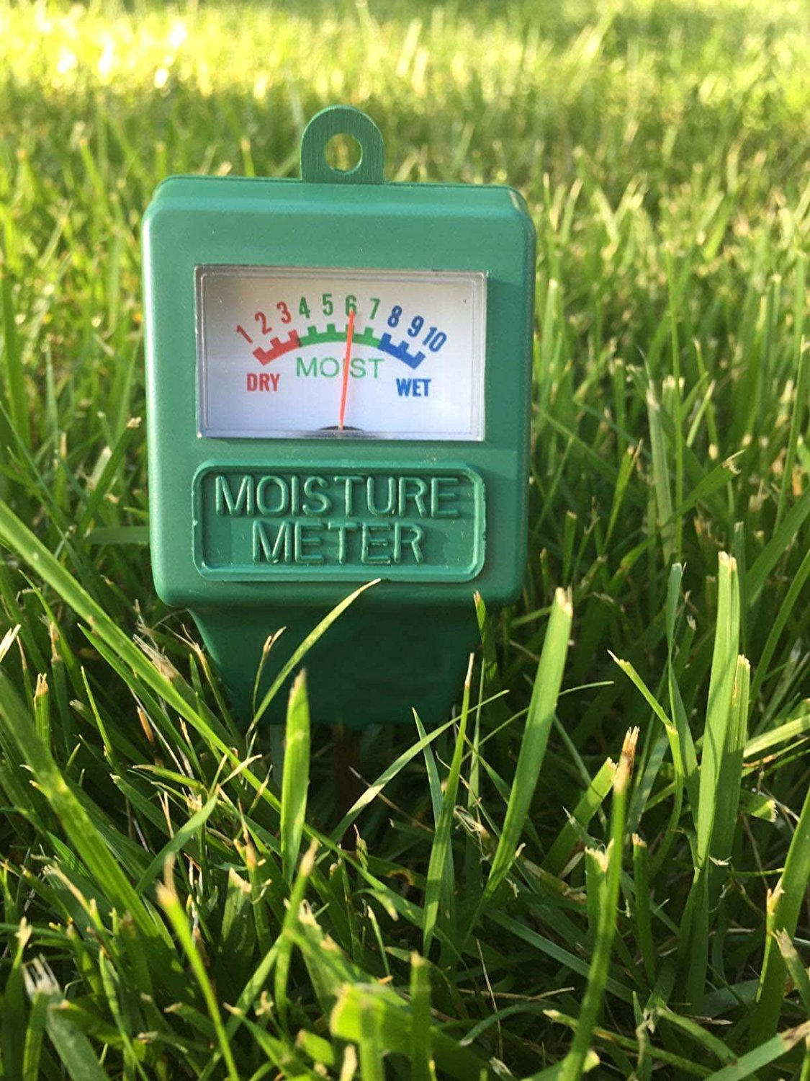
Features: Automatic Watering
Optimal moisture level is pulled from the database based on plant type and stored locally
The Raspberry Pi checks moisture levels and turns on pump if needed
Notes:
Dom

Slide 8
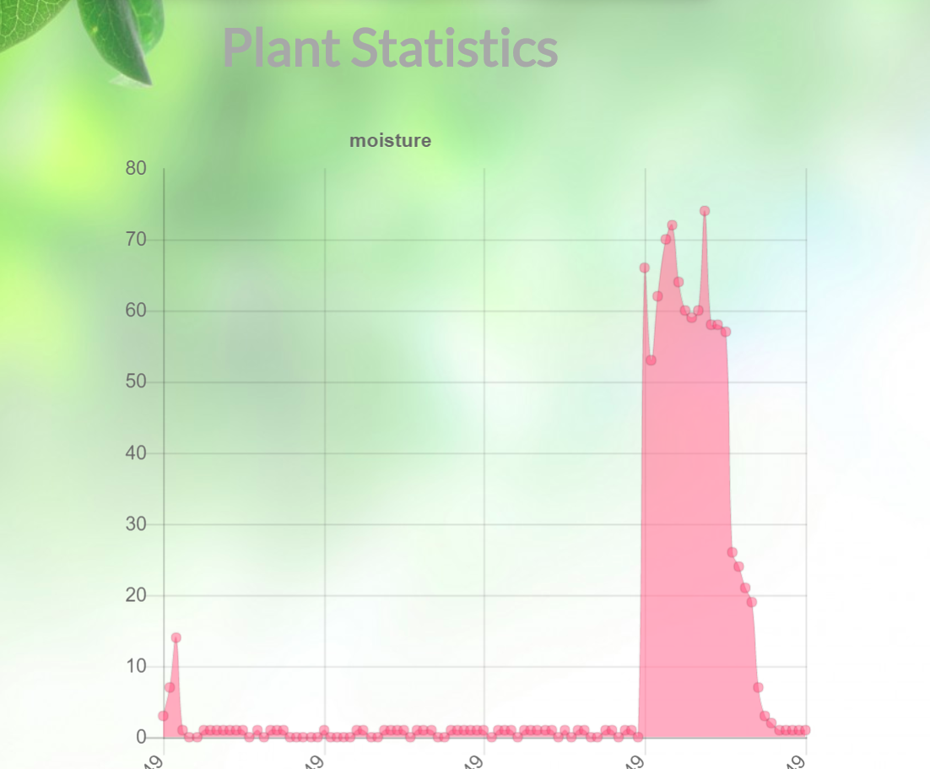
Features: Web and History
DB stores data from sensors and the website creates beautiful, scalable graphs
Temperature, humidity and moisture are recorded
Notes:
Wang

Slide 9
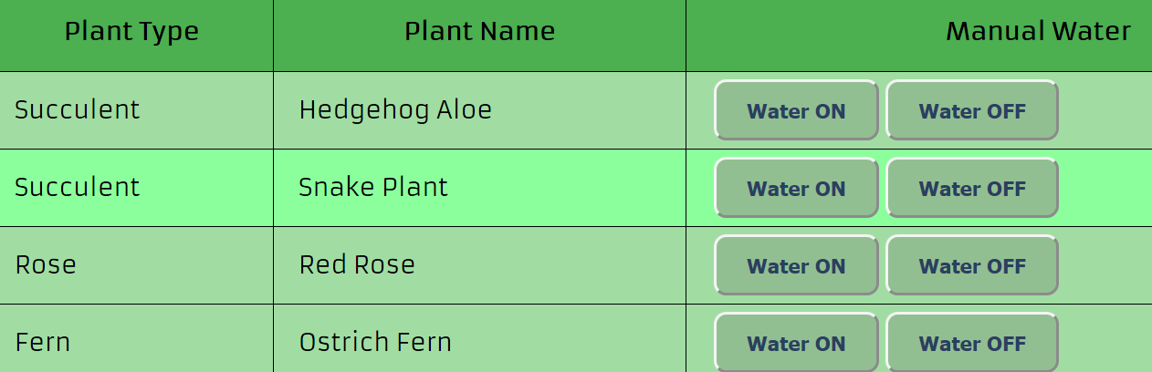
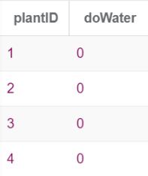
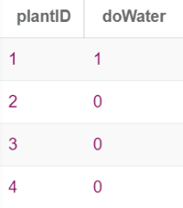
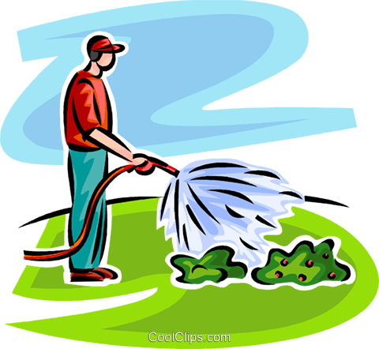
Features: Manual Watering (Web)
User’s plants retrieved and displayed
ON/OFF buttons set state for each plant in DB
Raspberry Pi reads DB
Raspberry Pi forwards state to Arduino
Arduino controls pump
Notes:
Roman

Slide 10





Technologies
C (for arduino)
Python (on RaspberryPi)
SQL
Javascript (node.js, AJAX, RESTful API)
HTML/CSS
Notes:
Andy

Slide 11
Database Schema
User(username, password, name)
Owner(plantID, username)
Plant(plantId, plantType, plantName)
History(plantId, recordDate, moisture, humidity, temp)
Optimal(plantType, potMoisture, optHumidity, optTemp)
ManualWater(plantId, doWater)
Notes:
Andy

Slide 12
Hardware Code
Diagram:
(board)
Script:
While loop that constantly uploads observed values to the database, and constantly checks if it needs to manually water the plant.
Communicates with the database by making HTTP requests to our website backend
Notes:
Andy

Slide 13
Website Code
JQuery for switching views
nodeJS for backend, and querying the database
Make an HTTP request to backend whenever data is needed
ChartJS for visualizing beautiful and powerful HTML5 based graphs.
Notes:
Andy

Slide 14


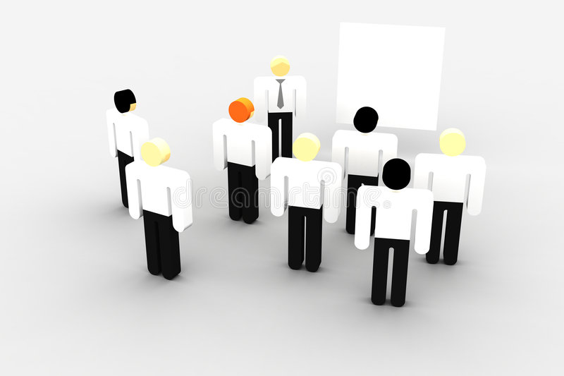
Software Process
Communication:
Messenger
Github
Meetings:
Whiteboard
For decision Making /Assigning Tasks
Assigning tasks: (based on skills and interest)
Dom: Hardware (Arduino)
Andy: Hardware (RaspberryPi)
Roman: Web (Database and node.js)
Dean: Web (UI/Aesthetics)
Eugene: Web (Controls/Navigation)
Daniel: Data Analytics and Web (Graphing)
Notes:
All

Slide 15
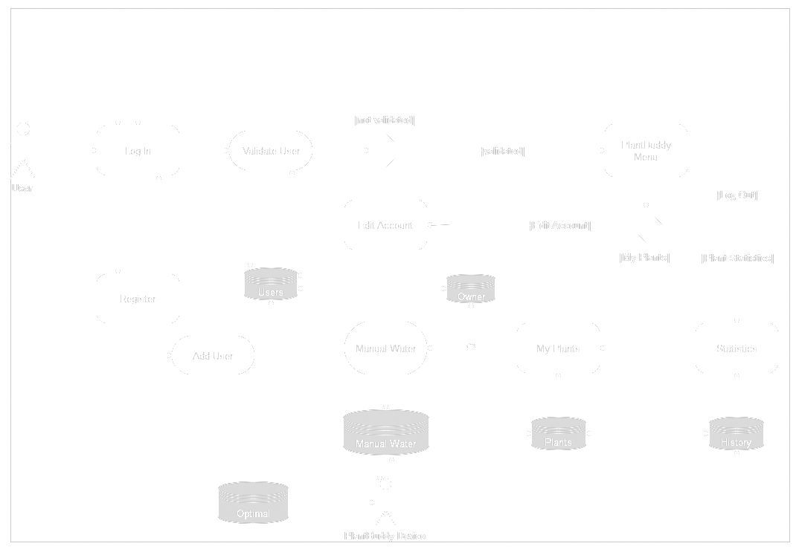
Software Architecture
Notes:
Dean

Slide 16
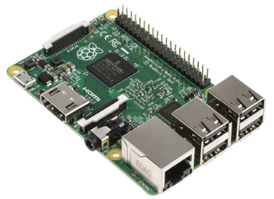


Challenges
Technological:
Communication between Pi, and Web, and Database
Pivotal Trackers
Choosing language for front end
Physical:
Obtaining Materials
Power Delivery
Notes:
All

Slide 17
The End
Questions?

